Slide 1
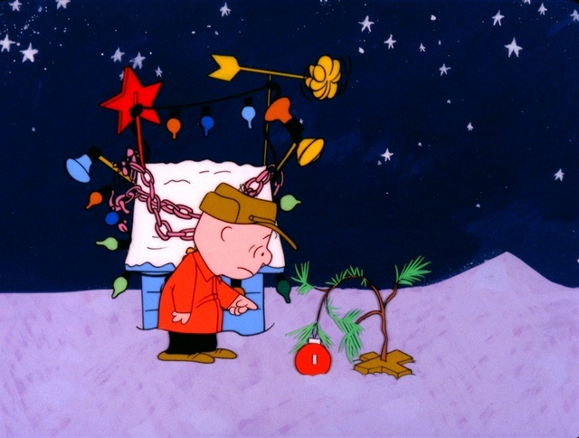

Slide 2
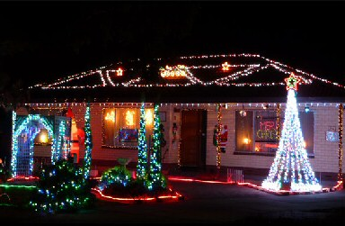
Christmas Lights Animation
By Interactive Lighting
By:
Austin Wentz and Jordan Doell

Slide 3

Summary of project:
Christmas Lights Animation
Sponsor - L3 Communications
Description - Christmas lights synced to music and controlled via an iPhone

Slide 4
Analysis:
Christmas Lights Animation
Analysis
Sprints
Live Demo
Use SSR’s to power lights on and off
Laptop running XBMC, connected to a separate controller
Connect controller to SSR’s
Develop an iPhone app that can connect to the system from any wireless location

Slide 5
Sprint 4:
Christmas Lights Animation
Analysis
Sprints
Live Demo
Sprint 4
Sprint 5
Backlog
Configure EC2 server to act as middleman between iPhone app and Christmas lights
Develop RESTful web service to allow iPhone to send commands and Raspberry Pi to get commands
Begin connecting iOS framework to UI

Slide 6
Sprint 5:
Christmas Lights Animation
Analysis
Sprints
Live Demo
Sprint 4
Sprint 5
Backlog
Implement client code on Raspberry Pi/laptop
Refine RESTful web service on EC2 server
Reworked app interface
Send JSON from iPhone to server

Slide 7
Backlog:
Christmas Lights Animation
Analysis
Sprints
Live Demo
Sprint 4
Sprint 5
Backlog
Test web service
Test client code
Test iOS App

Slide 8

Live Demo!
Christmas Lights Animation
Analysis
Sprints
Live Demo

Slide 9

Questions?
Christmas Lights Animation

